Slide 1
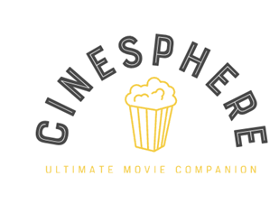
CineSphere
AI Powered Entertainment Guide
Abhishek Shankar

Slide 2
Contents
Problem Statement
Solution
About the data
Building the graph
Functionalities
Demo + Use Cases
Future Scopes

Slide 3

Problem Statement
Wasting time trying to find the right movie to watch on a Friday night?
How can we simplify the discovery of world cinema while addressing diverse user queries about movies, actors, and genres, all within a personalized, interactive, and seamless experience?

Slide 4
Solution
Interactive User Interface and experience
Personalised movie recommendations based on user preferences
Q&A bot to cater to user queries
Instant movie suggestions tailored to user sentiments
Wide variety of world cinema
Using State of the art tools like
Neo4j
OpenAI
Streamlit

Slide 5
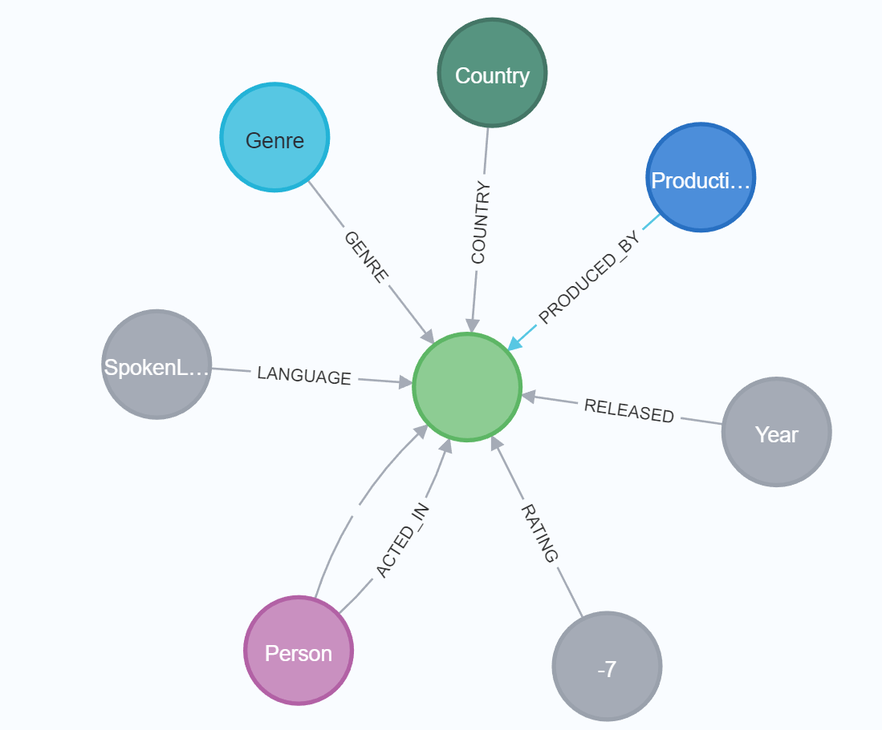
About the Data
The dataset was obtained from Kaggle and consists of over 45000 movies.
Data points include cast, crew, plot keywords, budget, revenue, posters, release dates, languages, production companies, countries, TMDB vote counts and vote averages
Movie

Slide 6
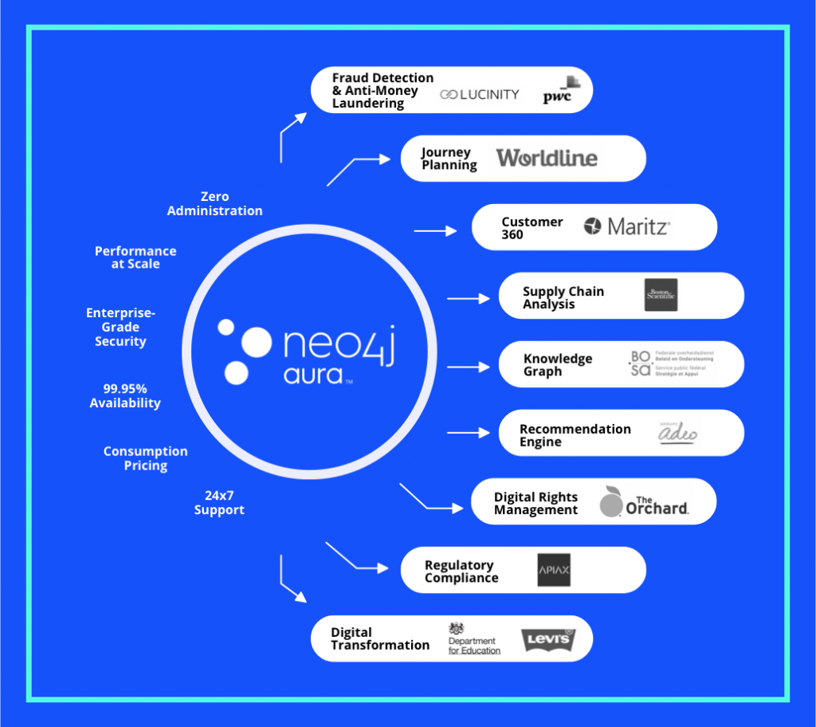
Why Use a Graph Database
Handling Complex Relationships
Efficient Querying
Recommendation Systems
Scalability
Real-time Recommendations

Slide 7
SQL Query | Macros Query on MS Excel | Cypher Query
SELECT m.*, r.*, related.* FROM movies_metadata_clean_2 m LEFT JOIN clean_ratings r ON m.movie_id = r.movie_id LEFT JOIN normalised_production_companies pc ON m.movie_id = pc.movie_id LEFT JOIN normalised_genres g ON m.movie_id = g.movie_id LEFT JOIN normalised_spoken_languages sl ON m.movie_id = sl.movie_id LEFT JOIN normalised_production_countries pcn ON m.movie_id = pcn.movie_id LEFT JOIN keywords_clean k ON m.movie_id = k.movie_id LEFT JOIN normalised_cast2 c ON m.movie_id = c.movie_id LEFT JOIN normalised_crew cr ON m.movie_id = cr.movie_id WHERE m.name = 'Inception'; | Sub SearchMovieInExcel() Dim ws As Worksheet Dim movieName As String Dim movieRow As Long ' Set the worksheet containing movie data Set ws = ThisWorkbook.Sheets("movies_metadata_clean_2") ' Prompt the user to enter the movie name movieName = InputBox("Enter the movie name:") ' Find the row number of the movie with the given name movieRow = Application.WorksheetFunction.Match(movieName, ws.Range("A:A"), 0) ' If the movie is found, display its details If Not IsError(movieRow) Then MsgBox "Movie found at row " & movieRow ' You can access movie details using ws.Cells(movieRow, columnNumber) ' For example: ' Dim movieID As String ' movieID = ws.Cells(movieRow, 2).Value ' Assuming ID is in column B ' MsgBox "Movie ID: " & movieID Else MsgBox "Movie not found." End If End Sub | MATCH (m:Movie {name:'Inception'})-[r]-(related) RETURN m, r, related;

Slide 8
Building the graph
25%
50%
75%
100%
Data Cleaning
Creating Constraints
Batch Upload
Query Database
Taking necessary columns and normalising data points
Helps Speed up transactions to upload large datasets
Use special plugins to batch large datasets to upload faster
Check relationships and data points to ensure data quality

Slide 9
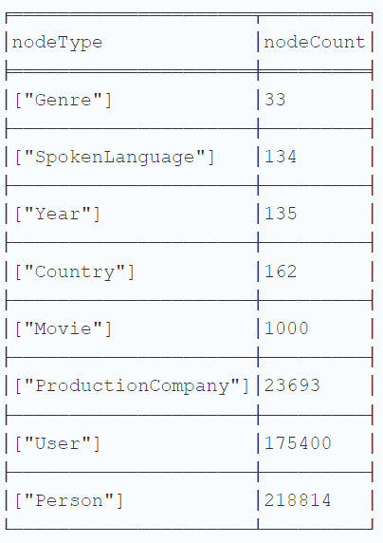
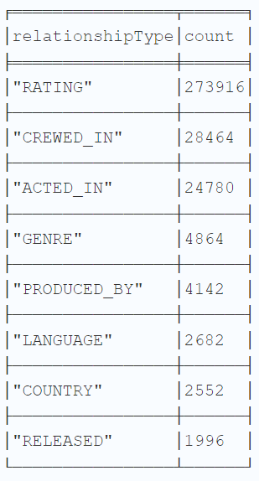
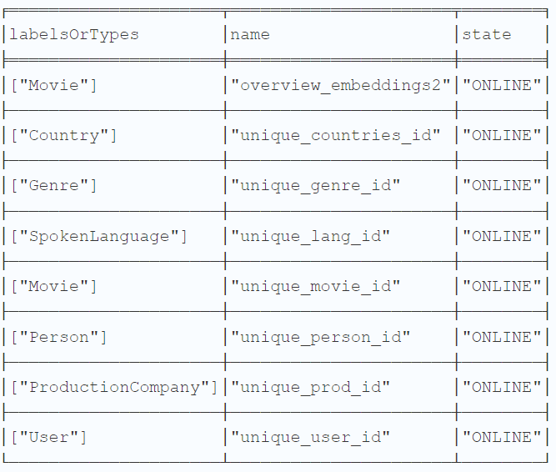
What does the graph contain?
Types of Relationships
Types of Indices
Types of Nodes

Slide 10
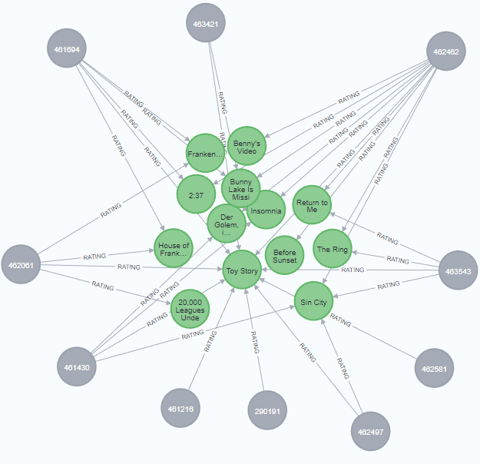
Functionalities - Personalised Recommendations
Users are given a set of movies based on the most popular movies in the database.
Node similarity is determined by measuring the distance between nodes, which is then filtered based on the collective characteristics of the nodes.
We aim to identify in relation to the source node that serves as the reference point.

Slide 11
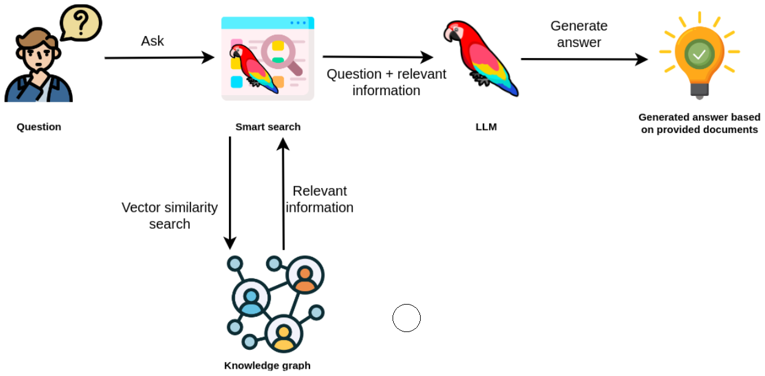
Functionalities - Vector Search

Slide 12
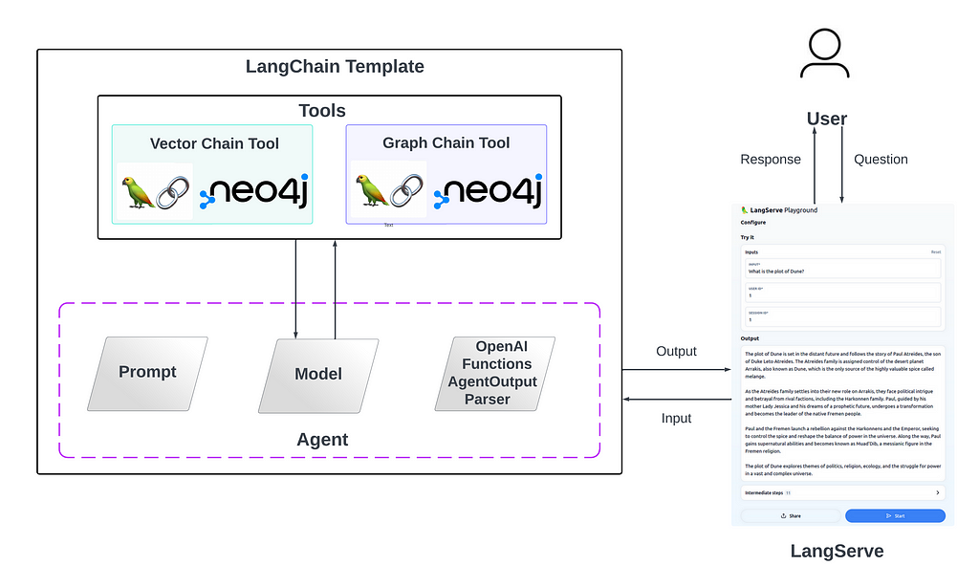
Functionality - Q&A Bot

Slide 13
Chat Interface - Multi-Agent Tool
CineSphere ChatBot
Routing
Using OpenAI Function Calling, LangChain Agents
Movie Q&A (Cypher Generation)
Using LangChain GraphCypherQAChain
Entity-Based Recommendations (Node Similarity)
Plot-Based Recommendation (Vector-Search)
Using OpenAI Embeddings and Vector Index

Slide 14
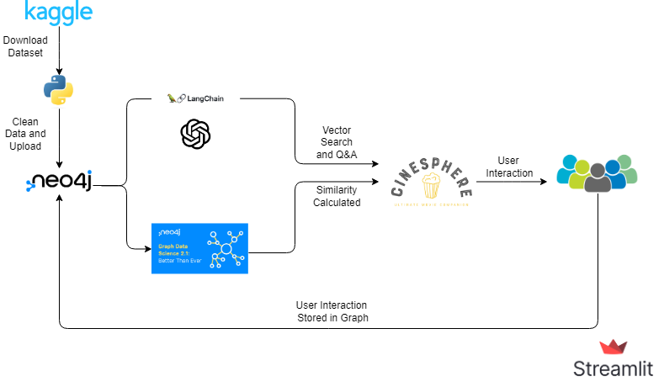
Product Workflow

Slide 15
Future Scopes
Optimised recommendations based on
More parameters
User Interactions
Refined user interface to facilitate more features
Add conversation history in Chat, and personalisation
Reduced latency and increased concurrency
Developing a hybrid vector search

